Slide 1

Predicting Housing Market
Group 3
Aadit Malikayil
Bhavika Karale
Kapil Tare
Shreyas Kashyap

Slide 2
Project Overview + Goals
Project Overview : To predict if a housing market is a "buyer's" market or a "seller's" market.
Buyer's market – represents a higher demand for houses than supply
Seller's market – represents a higher supply of houses than demand.
Neutral Market
Integration of 8 different datasets:
5 Zillow datasets (sales, housing value, days to pending/close, market heat index).
Long Term Treasury Bill Rates
Number of Building Permits
List of failed banks

Slide 3
Prediction and Inference
The team expects 'Median Days to Pending', 'LT Real Average', 'Median NH Values' and 'Number of failed banks' to be strong predictors for the type of market condition.
A lower value for median days to pending should indicate that there is higher demand. (Buyers are more ready to take the first steps towards buying a house)
We expect a negative correlation with Median NH Values and Market Temp Index Values
Since Long-term federal rates are directly related with mortgage rates, lower long-term rates should correlate with lower market temp values, indicating a higher demand for houses than supply.
Number of failed banks in a city should negatively impact the housing market and reduce the number of lending activity in a city.

Slide 4
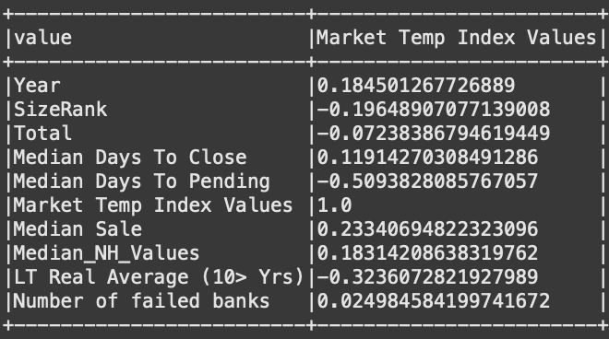
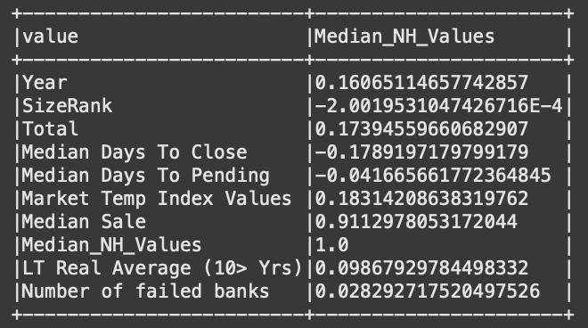
Data Exploration - Correlation
We can see that the correlation values are low among the numerical features with respect to both Market Temp Index Values and Median NH Values.
With Market Temp Index Values representing our target variable, we can see that Median Days to Pending has the greatest correlation with Market Temp index values.

Slide 5
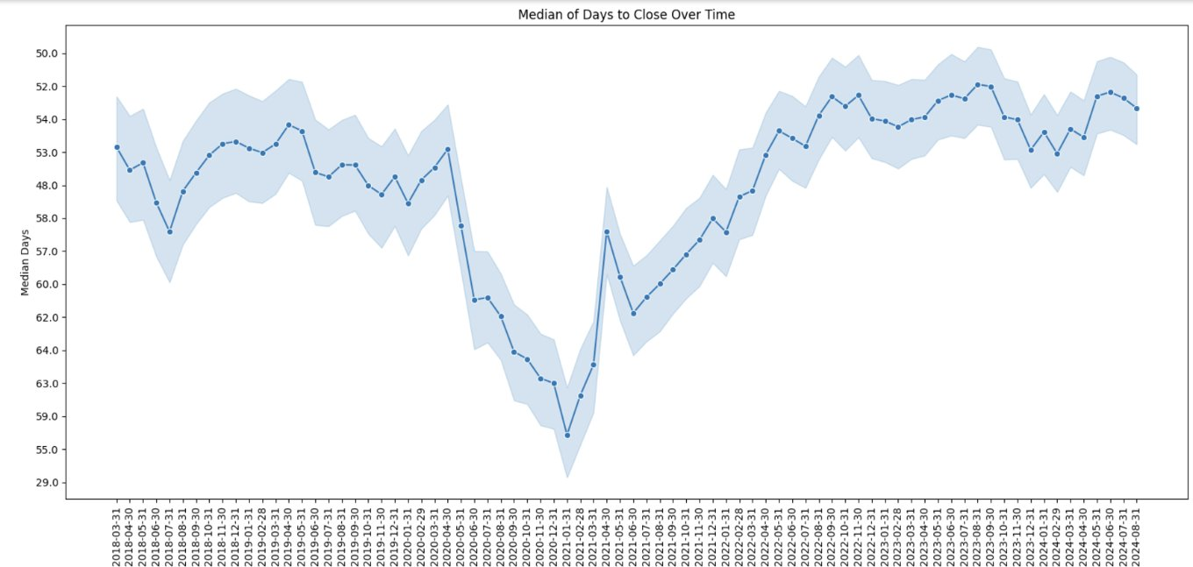
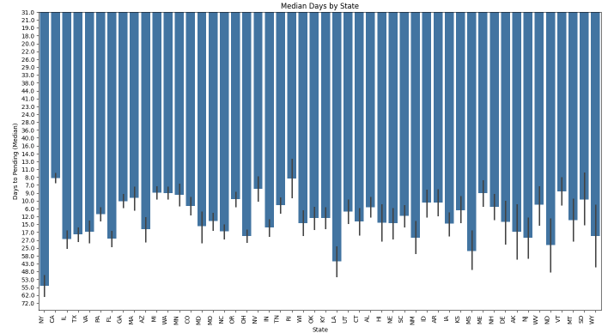
Data Exploration 1.1
Plot for Median Days to Close over Time
Plot for Median Days to Pending by State
The graph shows median days to close over time. It illustrates the fluctuations over time. There is a rapid increase and decrease with some sharp dips.
The graph shows median days to pending by state. It varies across states and NY, LA have the highest days to pending. It takes longer time where the population is high compared to smaller states with low population.

Slide 6
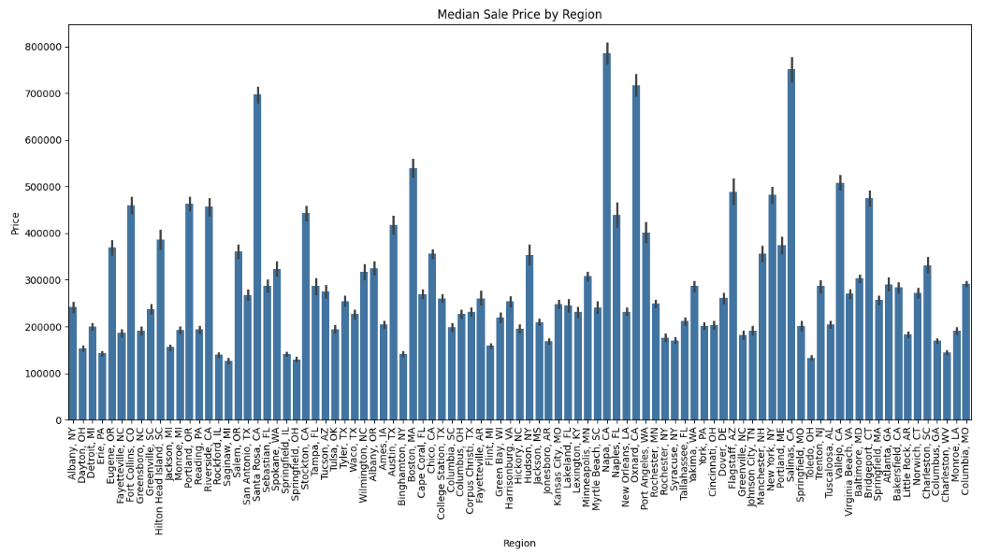
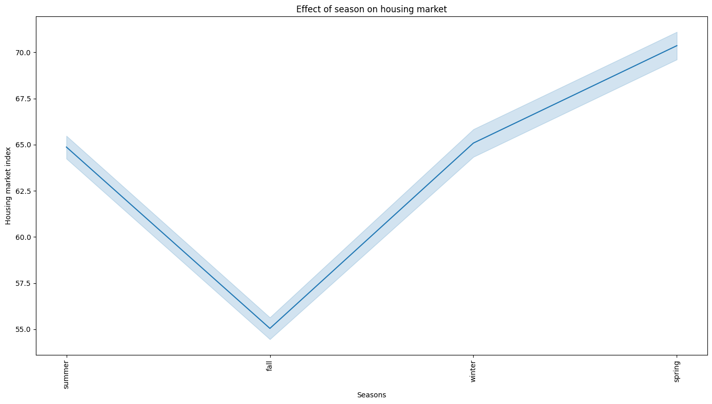
Data Exploration 1.2
Plot for Median Sale Price by Region
The graph shows median sale price by region. NY, CA have higher selling prices compared to developing markets.
The graph shows housing market index over seasons. It illustrates the fluctuations over seasons.

Slide 7
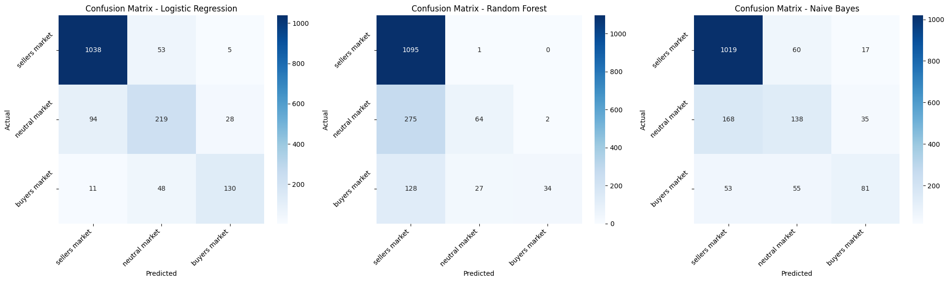
Results and Summary
Model Performance – Confusion Matrices Analysis
Logistic Regression –
Excellent model performance can be observed for the seller market (accuracy score of 94.7%)
Notable confusion between neutral-buyer classes (76 misclassifications)
Overall, this model has the best balance across all classes
Random Forest –
Highly evident that the model is overfitted due to the near-perfect seller market prediction (accuracy of 99.9%)
Significant misclassification of neutral/buyer as sellers can be observed hence leading to a poor performance in distinguishing neutral/buyer market
Naïve Bayes –
Strong sellers market detection can be observed (92.9% accuracy)
Model performs moderately in classifying the neutrals/buyers markets
Overall, more balanced performance across classes compared to random forest

Slide 8
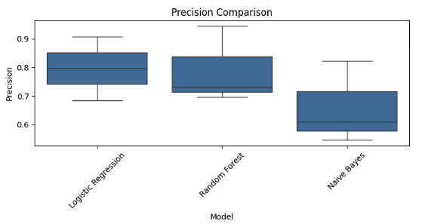
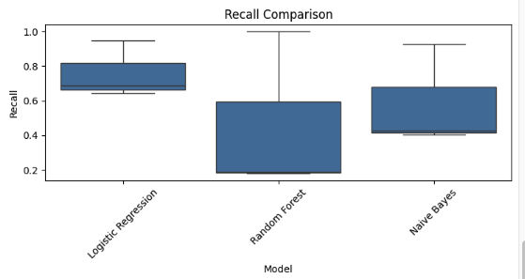
Results and Summary
Model Performance – Evaluation Metrics Analysis
LR shows the highest median precision (~0.80) compared to Random Forest and Naïve Bayes
NB has the lowest precision compared to LR and RF but with a high spread (between 0.55 to 0.85)
LR yields us the highest recall (~0.75) with the least variability
Extreme variability (0.2 to 1.0) across the classes can be observed for RF
Compared to RF, NB performs moderately better with a midrange spread

Slide 9
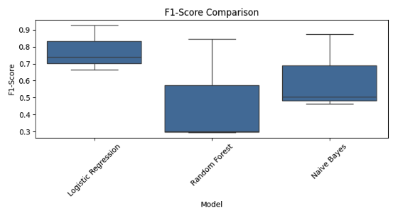
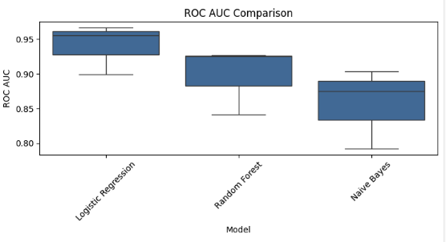
Results and Summary
Model Performance – Evaluation Metrics Analysis
Best F1 score stability can be observed for the LR model compared to RF and NB
NB performs better than RF but below LR
Lowest F1-scores can be observed for RF model with the highest variance
Across all 3 models, a strong AUC score (>0.85) can be observed
NB displays a competitive AUC score despite lower precision/recall

Slide 10
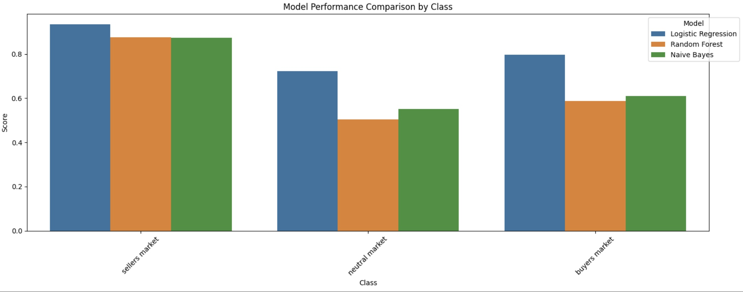
Results and Summary
Model Performance Summary - F1 Score Comparison basis Market Type

Slide 11
Problems Encountered
Getting crime data for every state was time consuming as the data found was mainly available city-wise and aggregated across the number of years
Adding mortgage rates: Used term frequency rates which correlated with the date-wise mortgage rates.
Building permits: Different file types and datatypes for the recent years and historical data.
More scope to add variability in the data for modelling.

Slide 12
Project Summary
Current results include all states in the USA present in the dataset. The time frame considered was between 2018 to 2024...
Currently we have 3 models. Logistic Regression seems to be the most optimal problem for our project goals.
Top 3 important features from RF Feature importance
Median Days To Pending
LT Real Average (10> Yrs)
Season_fall
Future scope:
Applying approx-smote to resolve class-imbalance
Developing inference on predictors against target variable

Slide 13

Thank you

Slide 14
Methods used to address issues
Data Transformation Methods used:
Spark functions (unpivot, join, union, create map, lit)
Pandas and Numpy for Data Visualizations
From ml.stats, Correlation
String Indexer, One Hot Encoder, Vector Assembler, Standard Scaler
Data Modeling Methods used:
MulticlassClassificationEvaluator, ROC-AUC, CrossValidator
Logistic Regression, Random Forest Classifier, Naïve Bayes
Random Forest Feature Importance

